Slide 1
Background Images & Double Buffering
IN628 Intermediate Architectures and Algorithms
Semester 2, 2016
Session 4.2
Notes:
Start with demo
There’s a detailed handout for this as well, but it’s tricky so we will discuss it first

Slide 2
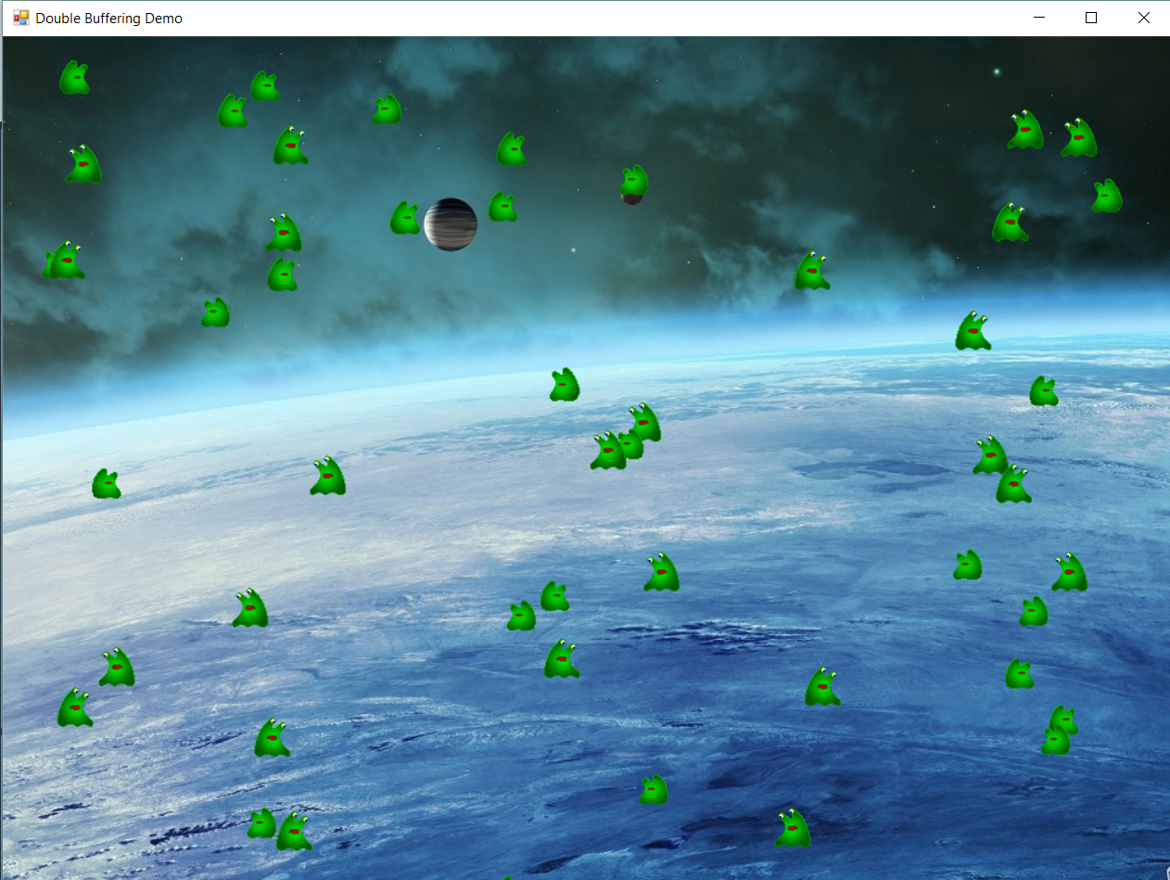
Using Background Images
Notes:
Eventually we are going to use a more complex technique for generating our backgrounds (because our world will be bigger than the screen), but the first step is to allow an image behind.
How might we do this? We can’t use a PictureBox because it covers the canvas.
We can’t DrawImage to the mainCanvas at the start and then forget it, because when our Sprites erase themselves they will leave coloured rectangles all over the place
We could, at each timer tick, DrawImage to the mainCanvas, and then draw all the sprites on top. This will work fine. As long as they are drawing to the same Graphics^, the Form and the Sprites can both draw with no problem.
Unfortunately, this causes multiple screen refreshes, which will rapidly lead to flicker.
So we use another technique, called ‘double buffering’

Slide 3
Double Buffering
Create a Bitmap instance (an in-memory object; the ‘buffer’)
Create a canvas on the Bitmap instance (an in-memory drawing surface).
Draw your background image to the in-memory canvas
Have all the sprites draw to the in-memory canvas
Draw the Bitmap to the Form’s canvas (i.e. to the screen)
Notes:
With double buffering, we make a drawing surface that only exists as a memory object.
That is, it has no visual representation on the screen. We draw to it exactly like we draw to the Form’s canvas, and it saves that information exactly like the Form’s canvas does, but it doesn’t display itself in the application window.
When you draw to it, the screen is not affected.
We can draw to it as many times as we want without flicker because it is not a visible object
Then, when that surface is all ready, we flick it out to the form’s visible canvas.

Slide 4
Making an in-memory drawing surface
Create a Bitmap of the size you require
Bitmap^ offScreenBitmap = gcnew Bitmap(1024, 768);
Create a Graphics bound to the Bitmap
Graphics^ offScreenCanvas = Graphics::FromImage(offScreenBitmap);
Draw on the Graphics as usual
offScreenCanvas->DrawImage(backGroundImage, 0, 0)
Draw the Bitmap to your main Form canvas
formCanvas->Drawimage(offScreenBitmap, x,y);
Notes:
There is a little syntactic magic required here...
This Graphics::FromImage command is another one of those special .NET things. These built-in classes, like Graphics and Image, have lots of interesting static methods you can use
This creates a Graphics surface on the Bitmap object
Actually have to be a little careful with the 0,0 thing if you are moving between machines of different pixel ratios. If you want to do so, give DrawImage a Rectangle, rather than x and y. It has an overload that will take it.
Before you draw to the Form, you could also have all your sprites draw to the offScreenCanvas, if you wish.
How do you arrange for the Sprites to draw to the offScreenCanvas? Pass it to them. In their Draw() method, they use whatever canvas they are given. They will never know the difference.

Slide 5
Adding a Background Image
Create a global Image object and initialise it with your background picture.
Create your in-memory Bitmap^ offScreenBitmap and Graphics^ offScreenCanvas as described on the previous slide.
At each game cycle:
Draw the background image to offScreenCanvas
Have your sprites draw themselves to offScreenCanvas
Draw offScreenBitmap to the Form.
Notes:
How do you get your sprites to draw themselves to the offScreenCanvas? Pass it in to them when you create them.

Slide 6
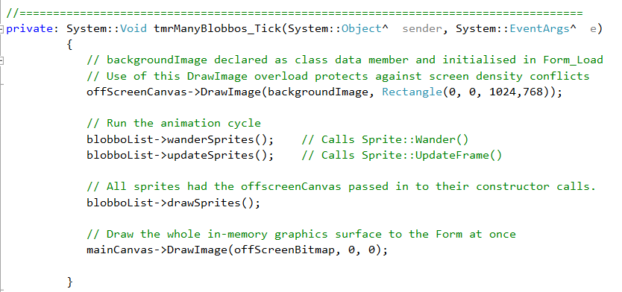
Timer Code
Notes:
In the demo there is knight and a bunch of chickens. They are all Sprites who were given the offScreenCanvas at creation
Note that you can do a million things to offScreen buffer without worrying about flicker. All that work happens in memory. All you do is one draw per timer tick, so no flicker.

Slide 7
Summary
In the Form_Load
Create an Image holding your background picture
Create a Bitmap the size of your background
Create a canvas (Graphics) from the Bitmap
Create your Sprites, passing in this canvas
Create your mainCanvas with CreateGraphics()
In the Timer
Draw the background Image to the offScreen canvas
Have the list make the sprites draw themselves (they draw to the offScreen canvas)
Draw the Bitmap to the mainCanvas
Notes:
Practical Handout

Slide 8
Practical – Duplicate the Demo App
Notes:
http://1wallpaper.net/earth-surface-planets-clouds-outer-space-cosmos-wallpaper.html#.V6pwPTXQBn0
NB: My Blobbos bounce off the edges. It’s ok if yours still wander off the screen.

